Slide 1

Internet of things flutter
Eng:Mena Alla Ashraf

Slide 2
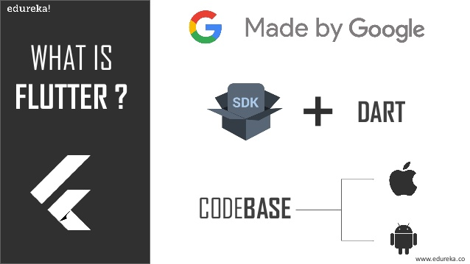
What is Flutter?
Flutter is an open-source UI software development kit (SDK) created by Google. It is used to build natively compiled applications for mobile, web, and desktop from a single codebase. Flutter uses the Dart programming language and provides a rich set of predesigned widgets that allow developers to create visually appealing and performant user interfaces.

Slide 3
Installing Flutter and Dart
Windows:
Download Flutter:
Visit the Flutter download page: https://flutter.dev/docs/get-started/install
Click on "Windows" to download the Flutter SDK.
Extract the Archive:
Extract the downloaded archive to a directory on your machine (e.g., C:\src\flutter).
Add Flutter to PATH:
Add the Flutter bin directory to your system PATH.
Open the Start Menu and search for "Environment Variables."
Under "System Variables," find the "Path" variable and click "Edit."
Add a new entry with the path to the bin directory of your Flutter installation (e.g., C:\src\flutter\bin).
Install Dart:
Flutter comes with the Dart SDK bundled, so you don't need to install Dart separately.
Verify Installation:
Open a Command Prompt or PowerShell window and run flutter doctor to ensure that Flutter is set up correctly.

Slide 4
1. Install Android Studio:
Download Android Studio from the official website: https://developer.android.com/studio
Follow the installation instructions for your operating system (Windows, macOS, Linux).
2. Install Flutter and Dart Plugins:
Open Android Studio.
Go to "File" > "Settings" (on macOS, it's "Android Studio" > "Preferences").
In the left pane, select "Plugins."
Search for "Flutter" and "Dart."
Install both plugins and follow any prompts to restart Android Studio.
3. Configure Flutter SDK:
After installing the Flutter plugin, you'll be prompted to configure the Flutter SDK location.
If not prompted, you can configure it later by going to "File" > "Settings" > "Languages & Frameworks" > "Flutter."
Click on the "Flutter SDK path" field and provide the path to your Flutter installation directory (e.g., /path/to/flutter).

Slide 5


Slide 6
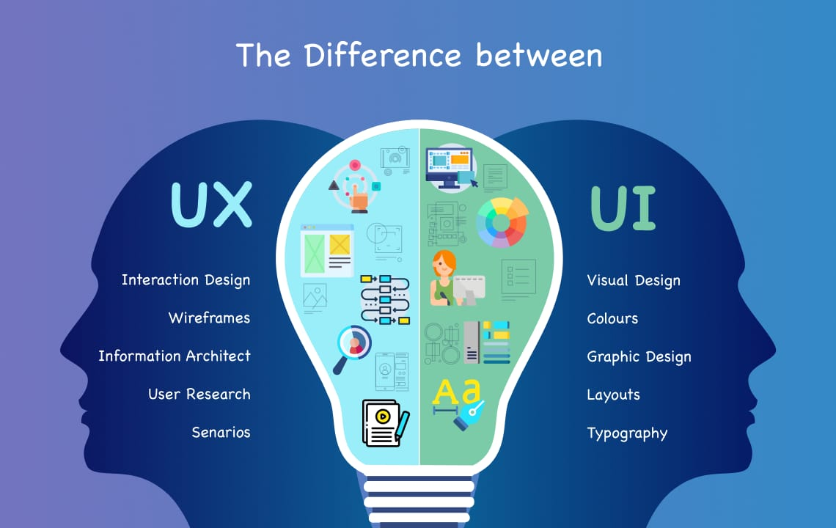

Slide 7
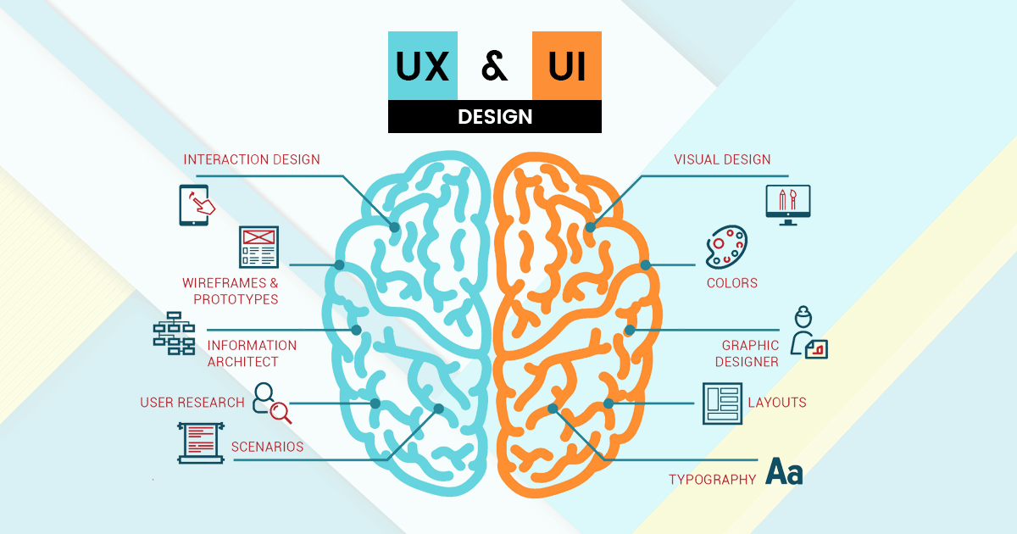

Slide 8
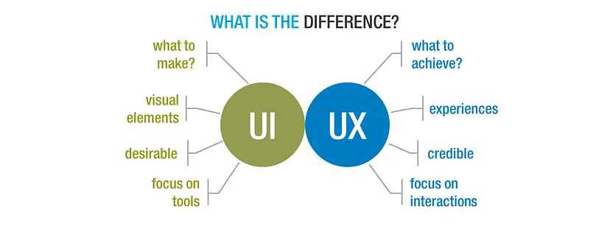
Let’s start with the basic difference between the two?

Slide 9
Ui(User Interface):
Visual Design: This aspect focuses on the aesthetics of your app, including colors, typography, icons, and overall visual style. It's about creating a visually consistent and pleasing design that reflects your app's brand.
Layout and Composition: Designing the layout involves arranging UI elements like buttons, text, images, and input fields in a logical and organized manner. Consistent alignment and spacing contribute to a balanced and attractive layout.
Hierarchy and Readability: Prioritize important content by using appropriate sizes, colors, and styles. Use typography that's easy to read and ensures good contrast between text and background.
Icons and Imagery: Use icons and images that are relevant and support the app's functionality. Visual cues can help users understand the purpose of different elements.
Buttons and Controls: Design buttons and interactive elements in a way that makes them visually distinct. They should be easy to recognize and tap, contributing to intuitive navigation.

Slide 10
Ux(User Experience):
User-Centered Design: Put the user at the center of your design decisions. Understand their needs, behaviors, and expectations to create an app that meets their requirements.
User Flow: Design a logical and intuitive flow that guides users through the app's features and tasks. Consider how users will navigate, access information, and perform actions.
Simplicity and Clarity: Keep the app simple and avoid unnecessary complexity. Clear and straightforward interactions enhance the user experience.
Consistency: Maintain consistency across the app. Use the same design patterns, colors, and interactions to create a unified experience.
Feedback and Response: Provide feedback to users when they perform actions. This could be through animations, loading indicators, or success messages to keep users informed.
Efficiency: Design interactions to be efficient and minimize the number of steps required to complete tasks. Users appreciate apps that save them time and effort.
Accessibility: Ensure that your app is accessible to users with disabilities. Provide text alternatives for images, use sufficient contrast, and adhere to accessibility guidelines.
User Testing: Gather feedback from real users through usability testing. This helps identify pain points, areas for improvement, and validates the effectiveness of your design.

Slide 11

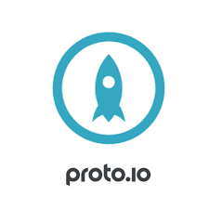
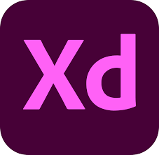


Programs for ui:

Slide 12
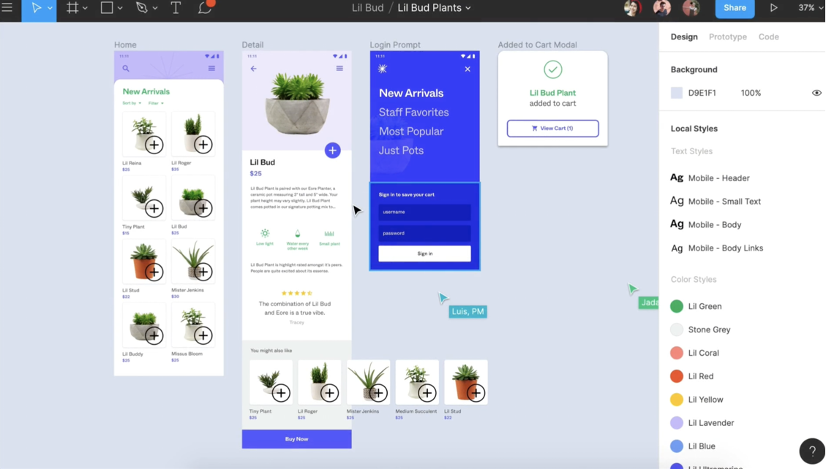

Slide 13
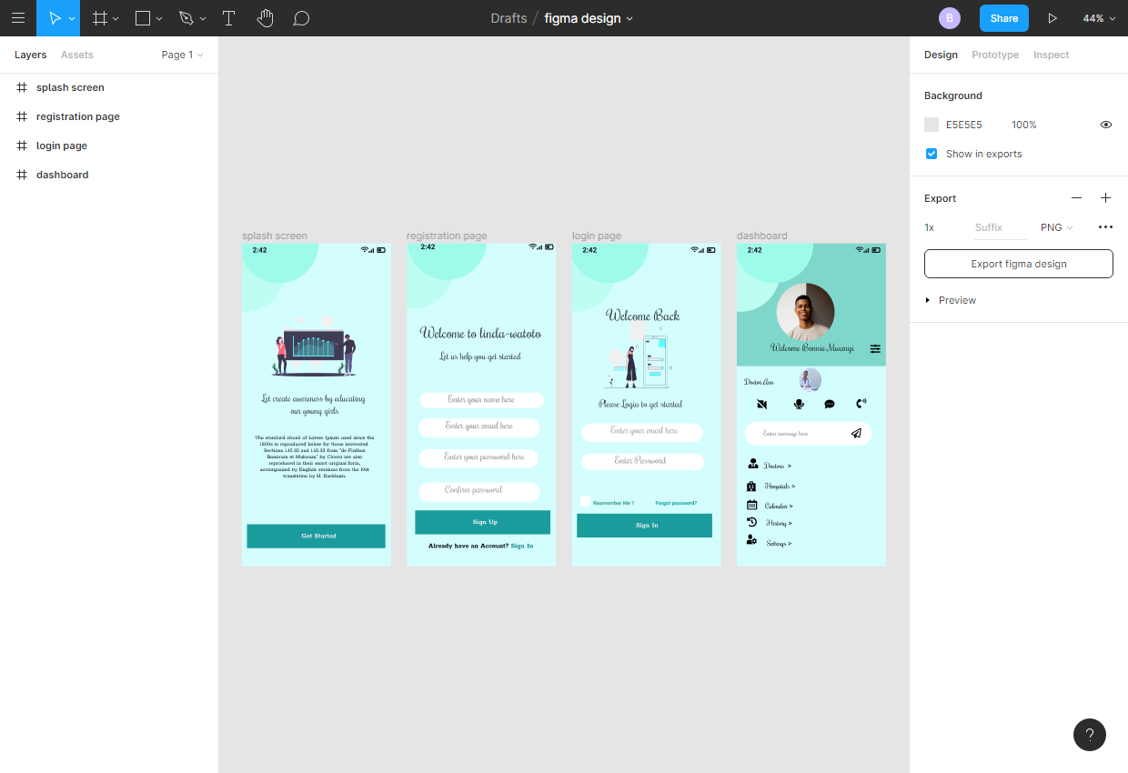

Slide 14
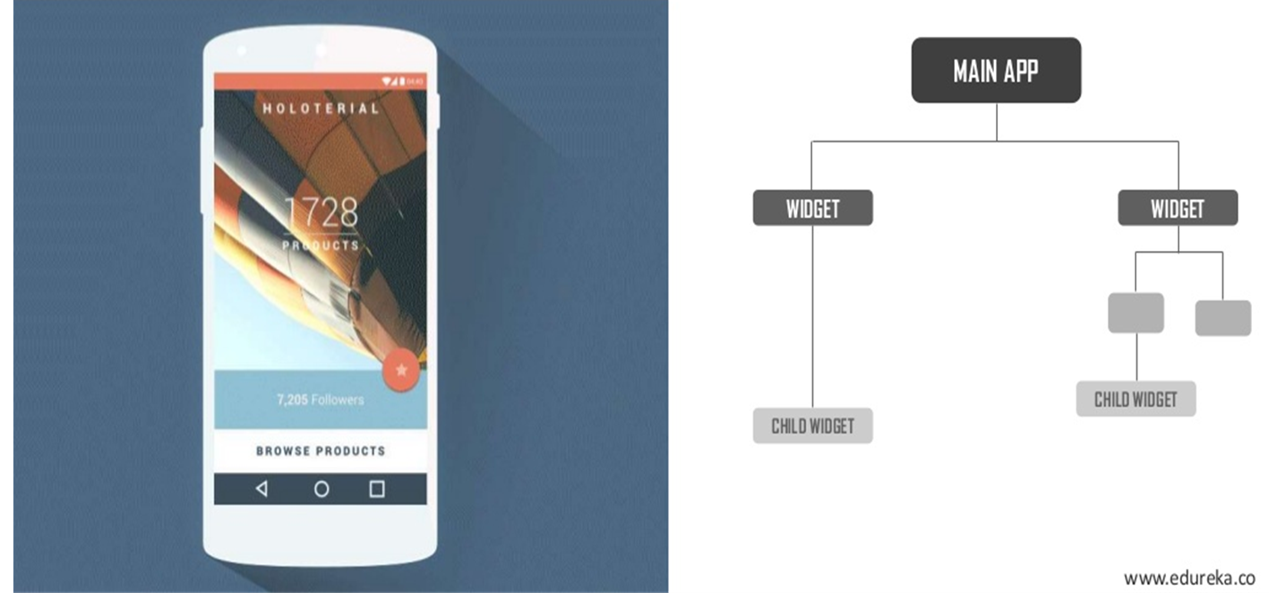
Flutter Architecture and Widgets

Slide 15
Understanding Flutter's Widget-Based Architecture:
Flutter follows a widget-based architecture, where everything is a widget. Widgets are building blocks of your app's UI, representing everything from structural elements like buttons to complex layouts. Explain the concept of the widget tree and how widgets are nested to create the UI hierarchy.

Slide 16
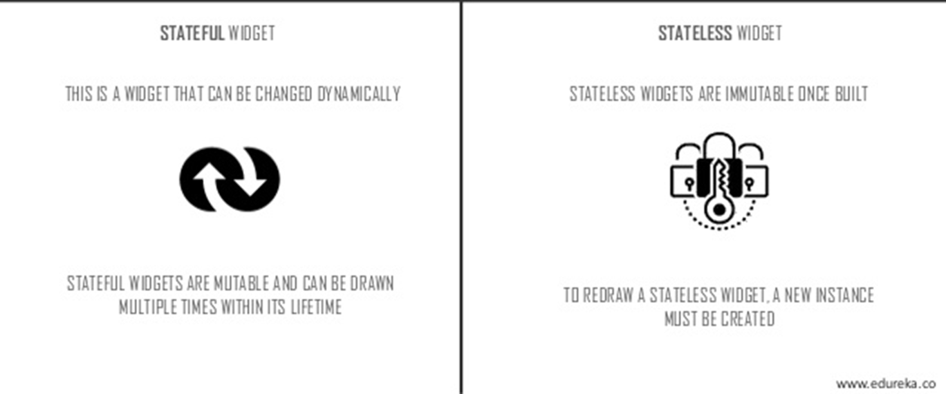
Type of widgets

Slide 17
Statefull and stateless widgets
Every thing in the application can be referred by widget the main function is divided into a set of widgets
A widget is either statefull or stateless. If a widget can change—when a user interacts with it, for example—it’s statefull.
A stateless widget never changes. Icon, Icon Button, and Text are examples of stateless widgets. Stateless widgets subclass Stateless Widget.
A statefull widget is dynamic: for example, it can change its appearance in response to events triggered by user interactions or when it receives data. Checkbox, Radio, Slider, InkWell, Form, and Text Field are examples of stateful widgets. Stateful widgets subclass Statefull Widget.
A widget’s state is stored in a State object, separating the widget’s state from its appearance. The state consists of values that can change,

Slide 18
Common Layout Widgets
1.Scaffold:
The Scaffold widget is a fundamental layout structure in Flutter that provides a basic framework for building app screens. It offers a variety of visual elements like app bars, drawers, floating action buttons, and more. A Scaffold typically holds a single main content area, which is specified by the body parameter
Scaffold(
appBar: AppBar(
title: Text('My App'),
),
body: // Your main content goes here,
// Other optional parameters like drawer, floatingActionButton, etc.
)

Slide 19
2. Container: The Container widget is a versatile widget that provides control over layout and styling. It can contain other widgets and allows you to customize properties such as padding, margin, alignment, and decoration. The decoration property lets you add backgrounds, borders, and other visual effects.
Container(
width: 200,
height: 200,
color: Colors.blue,
child: Text('Hello, Container!'),
)
.

Slide 20
3. Row and Column: Row and Column are used to arrange widgets horizontally and vertically, respectively. They automatically adjust the layout based on the available space and provide options for alignment and spacing between widgets.
Column(
crossAxisAlignment: CrossAxisAlignment.start,
children: [
Text('Title'),
Text('Subtitle'),
],
)

Slide 21
Child
The child property is used to define a single widget as the direct content of another widget. It's used when a widget should have only one child. This is commonly used with widgets that are meant to have a single content element, such as buttons, containers, images, text fields, and more.
Use child when you need to place a single widget as content, such as inside a Container, Card, or Button.
For instance, with the Container widget, you can set a single child widget that serves as the content of the container:
Container( child: Text('Hello, World!'), )

Slide 22
Children
The children property is used when a widget can have multiple children. It's often used with layout widgets like Row, Column, ListView, and Stack, which arrange and display multiple widgets horizontally, vertically, or in an overlapping manner
Column( Row(
children: [ children:[
Text('First Item'), Text('First Item'),
Text('Second Item'), Text('Second Item'),
Text('Third Item'), ],) Text('Third Item'), ],)

Slide 23
VARIABLES IN DART
Variables in Dart can be declared without data type var <variable_name>;
var msg;
var counter; or
var <name> = <expression>;
Type inference allows static deduction of types by analyzing the source code.
Var msg= “hi”; //string msg= “hi”;
var counter =10 ; // int counter= 10;

Slide 24
DART DATA TYPES
in Dart any variable is an object and types are considered as classes.
integer
double
string
boolean Dart Integer:- Integers are used to store whole numbers and declared by int keyword.
int age = 25; // var age =25;
Dart Double :- In Dart, double is used to represent floating-point numbers can be declared using double keyword.
double pi = 3.14; // var pi=3.14 ;
Dart Strings :- A string variable is used to hold series or sequence of characters – letters, numbers, can be declared using the String keyword.
var msg="Hello World!"; // string msg “Hello World!”;
Dart Boolean :- The Boolean data type is used to represent the truth valuesdeclared using bool keyword.
bool isValid = true;

Slide 25
FINAL AND CONST
The final and const keyword are used to declare constants.
Dart prevents modifying the values of a variable declared using the final or const keyword
void main() {
const pi = 3.14;
const area = pi*12*12;
print("The output is ${area}");
}
The output is 452.15999999999997

Slide 26
PRINT FUNCTION IN DART & USING $ { }
In Dart, print( ) function is used to print a value and ${expression} for variables
void main( ){
var name = “Samy";
var age = 25;
print("I am ${name} I am ${age} years old");
}
Output:-
I am Samy I am 25 years old

Slide 27
Calling a function
void printInteger (int aNumber) {
print ('The number is ${aNumber}'); // Print to console.
}
void main( ) {
var number = 42; // Declare and initialize a variable.
printInteger (number); // Call a function.
}

Slide 28
DART LIST
In Dart a List is an ordered group of objects.
The List data type is actually similar to the concept of an array in other programming languages.
In Dart, arrays are List objects, so most people just call them lists.
A list variable is defined by having values separated by commas and enclosed within square brackets ([]).
var list = [1, 2, 3];

Slide 29
LIST ADD ( )
To add new object <list_name>.add(<value>);
Example:-
void main() {
var even_list = [2,4,6,8];
print(even_list);
even_list.add(10);
print(even_list);
}
Output:-
[2, 4, 6, 8]
[2, 4, 6, 8, 10]

Slide 30
DART MAPS
The Map is an object that is used to represents a set of values as key-value pairs.
In Map, both keys and values can be of any type of object, it is not necessary that the keys and values both of the same type..
In Map, each key can only occurs once, but the same value can be used multiple times.
Syntax:
var <map_name> = {key1:value1, key2:value2,..., key_n:value_n}
Example
var weekDays = {'Day1': 'Mon', 'Day2': 'Tue', 'Day3': 'Wed', 'Day4': 'Thu'};

Slide 31
DART CLASSES
Dart is an object-oriented programming language; and supports the concepts of class, object, interfaces, inheritance, and abstract classes etc.
In Dart, a class can be defined as a blueprint or prototype of associated objects.
Class is a wrapper that binds/encapsulates the data and methods together; which can be later accessed by objects of that class.
Syntax:-
class ClassName {
<fields>
<functions>
}

Slide 32
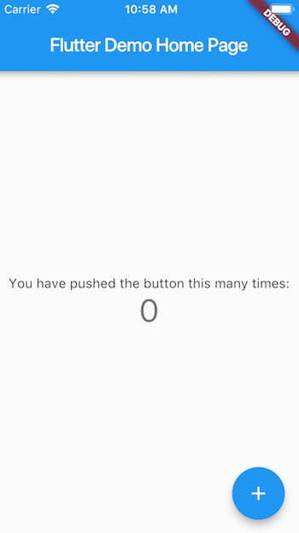
Create your first flutter app
Open android studio
File –new –new flutter project

Slide 33
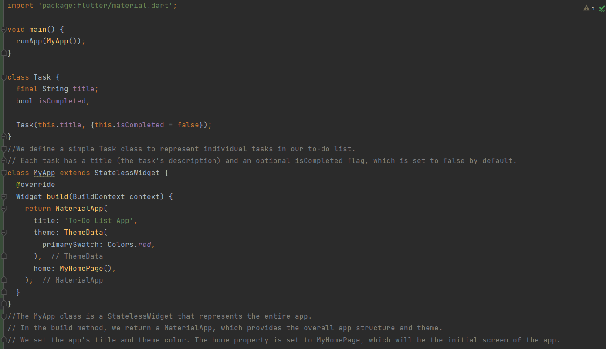
simple Flutter project that displays a basic "To-Do List" app

Slide 34
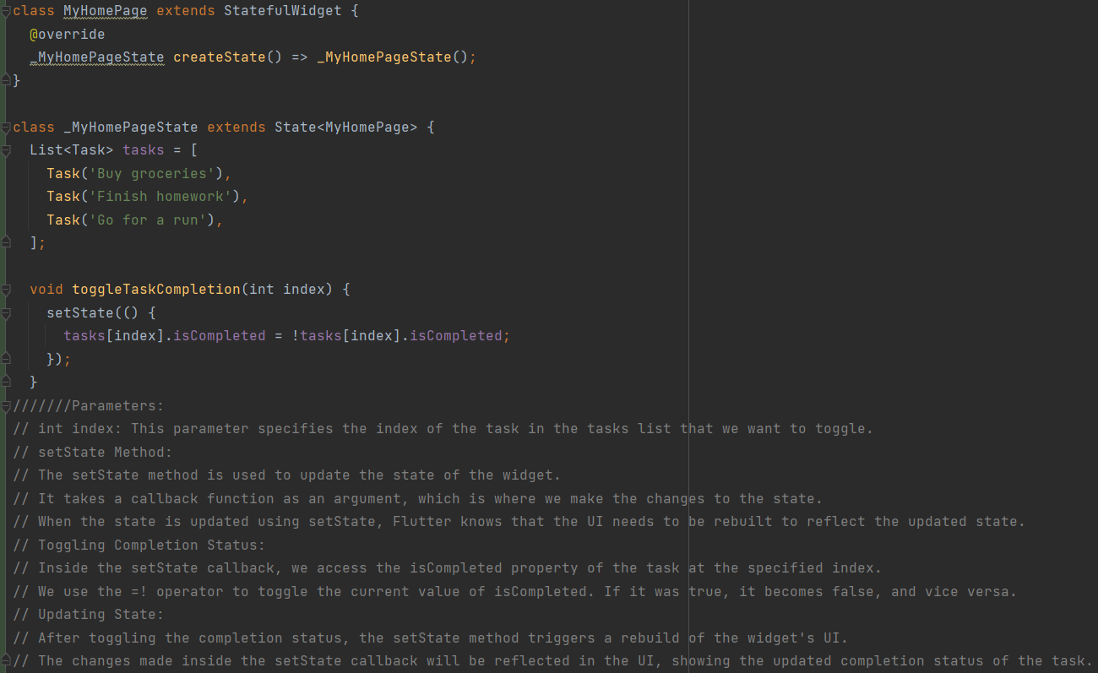

Slide 35
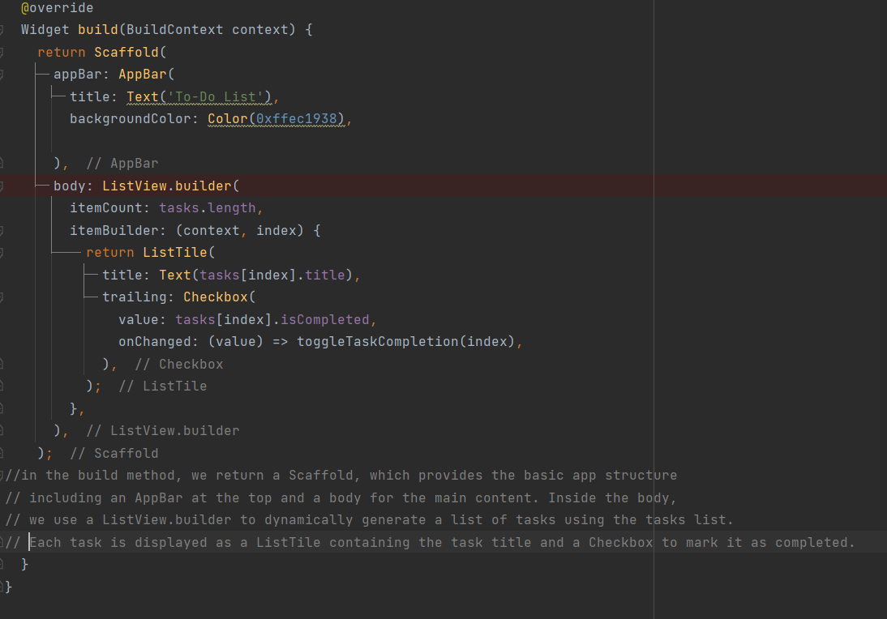

Slide 36
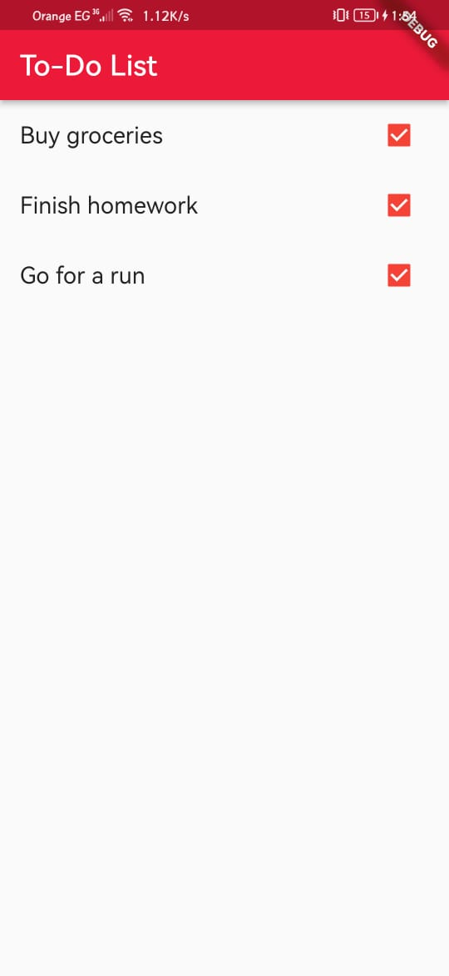
Run the code

Slide 37
Connecting your Android phone to your Flutter app
1. Enable Developer Options on Your Phone:
a. Open Settings: On your Android device, go to "Settings."
b. About Phone: Scroll down and find the "About Phone" or "Software Information" option.
c. Tap Build Number: Tap on "Build Number" multiple times (usually 7 times) until you see a message indicating that Developer Options are enabled.
2. Enable USB Debugging:
a. Developer Options: Once Developer Options are enabled, go back to the main "Settings" screen.
b. Developer Options: You should now see "Developer Options" or "System" > "Developer Options."
c. Enable USB Debugging: Inside Developer Options, find and enable "USB Debugging."

Slide 38
Create a Navigation Button
class HomeScreen extends StatelessWidget {
@override
Widget build(BuildContext context) {
return Scaffold(
appBar: AppBar(title: Text('Home Screen')),
body: Center(
child: ElevatedButton(
onPressed: () {
Navigator.pushNamed(context, '/details');
},
child: Text('Go to Details'),
),
),
);
}
}

Slide 39
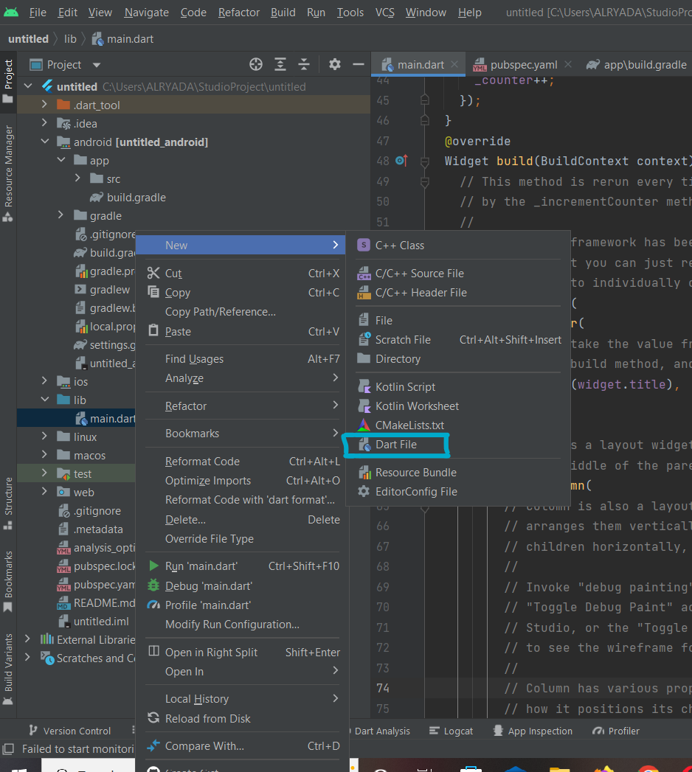
Create a new flutter page

Slide 40
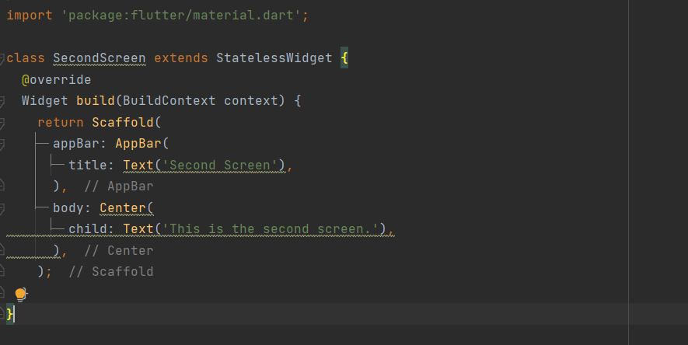
Second screen

Slide 41
Add to the main
import 'second_screen.dart';
ElevatedButton( onPressed: () { Navigator.push( context, MaterialPageRoute(builder: (context) => SecondScreen()), ); }, child: Text('Go to Second Screen'), ),

Slide 42
pubspec.yaml
The pubspec.yaml file is a critical part of Flutter app development. It's used to manage your app's dependencies, specify metadata, and configure other project settings

Slide 43
1. Project Metadata:
At the top of the pubspec.yaml file, you'll find metadata about your project, including its name, description, version, and author information.
2. Dependencies:
The dependencies section lists the packages your app depends on. These packages are downloaded from the Dart package repository (pub.dev) when you run flutter pub get.
3. Dev Dependencies:
The dev_dependencies section lists packages that are only needed during development. They are not included when you build the production version of your app.
4. Flutter Assets:
The assets section is used to declare any assets that your app uses, such as images, fonts, or configuration files.

Slide 44

Connect the project to Firebase
There are two ways:
For first way watch this video
https://youtu.be/EJHKGcDOrt4

Slide 45
Second way
1. Create a Firebase Project:
Go to the Firebase Console: https://console.firebase.google.com/
Click on "Add project" to create a new Firebase project.
Follow the prompts to set up the project, including project name and region.
2. Register Your App with Firebase:
After creating the project, click on "Add app" and select "Flutter."
Follow the instructions to register your Flutter app with Firebase. This includes providing the Android package name and iOS bundle identifier.
3. Download Configuration Files:
Once your app is registered, you'll be prompted to download configuration files for Android and iOS: google-services.json (for Android) and GoogleService-Info.plist (for iOS). These files contain settings and credentials for your app to connect to Firebase services.

